Slide 1
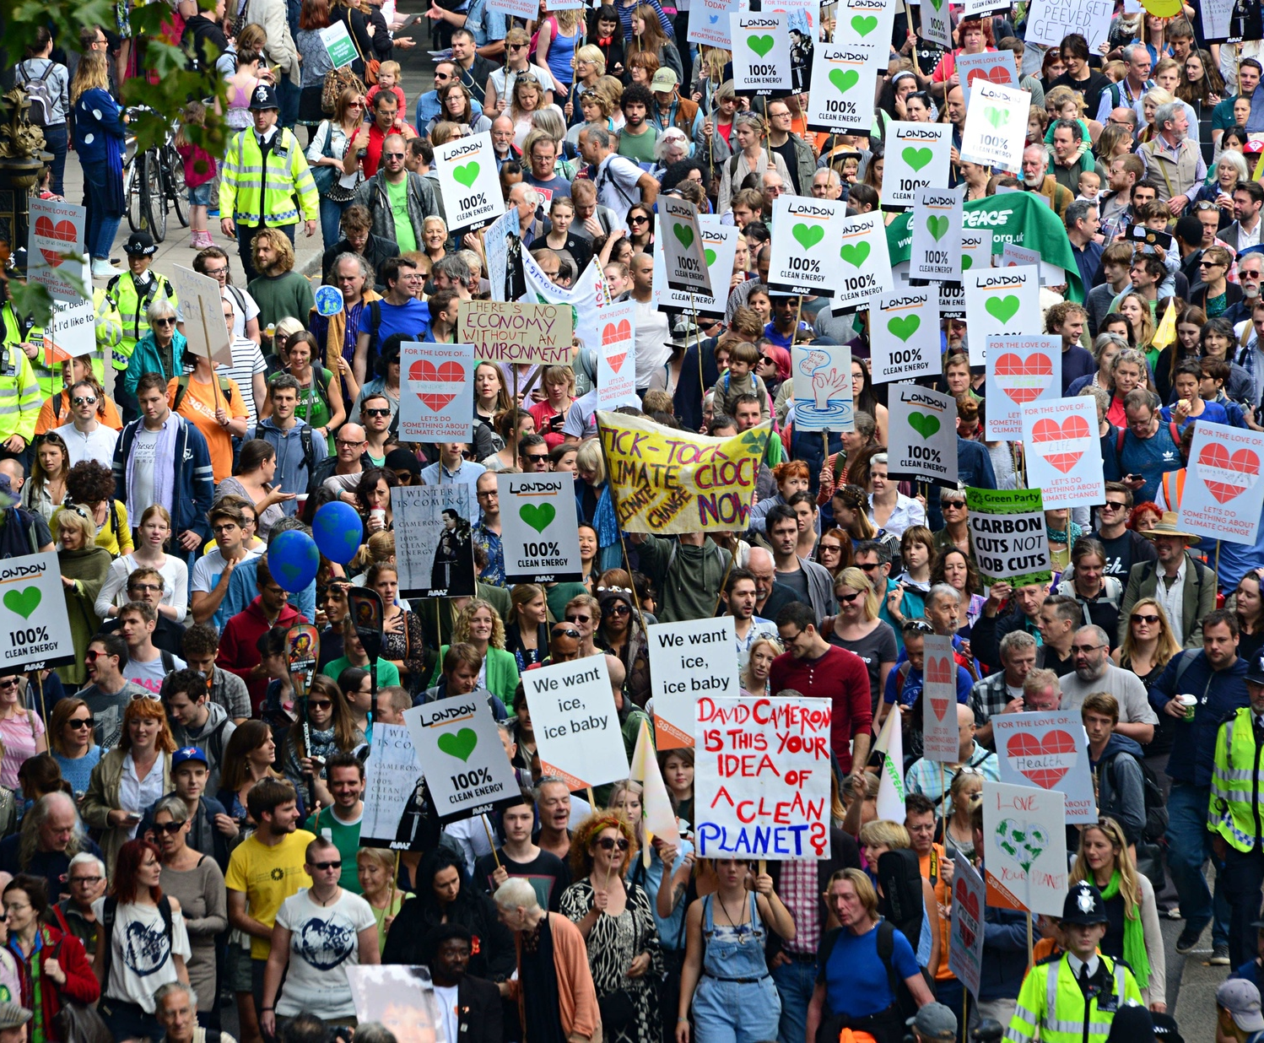
Perceptions, Policy and Public Protests:
A tool for analysing societies awareness of Climate Change in the UK
ONS Health Surveillance

Slide 2
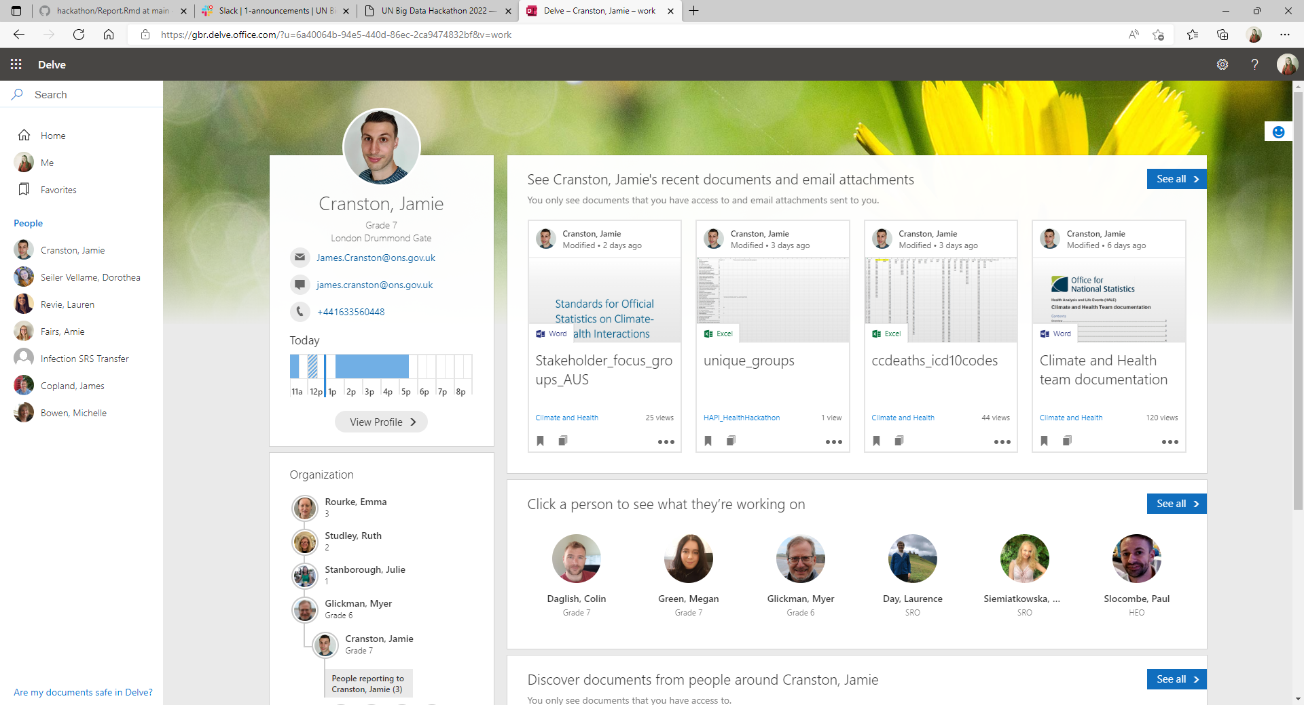
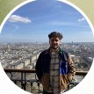
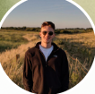
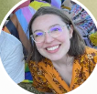
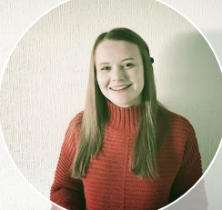
Who we are…
Jamie Cranston: Principal Analyst, Climate Change and Health, Office for National Statistics (UK).
james.cranston@ons.gov.uk
Joel Jones: Senior Research Officer, Coronavirus Infection Survey, Office for National Statistics (UK).
joel.jones@ons.gov.uk
Luis Dibdin: Senior Executive Officer, Coronavirus Infection Survey, Office for National Statistics (UK).
luis.dibdin@ons.gov.uk
Dorothea Seiler Vellame: Higher Executive Officer, Coronavirus Infection Survey, Office for National Statistics (UK).
dorothea.seiler.vellame@ons.gov.uk
Claudia Jenkins: Research Officer, Coronavirus Infection Survey, Office for National Statistics (UK).
claudia.jenkins@ons.gov.uk

Slide 3

The Project
‘To support policies caused by the impact of Climate Change on society as part of monitoring SDG 13’.
We decided to focus on two key SDG targets:
Target 13.2: Integrate climate change measures into national policies, strategies, and planning
Target 13.3: Improve education, awareness-raising and human and institutional capacity on climate change mitigation, adaptation, impact reduction and early warning.
Our Aim: To address the data gap between public perceptions of climate change (using the UK as an example) and national policy to allow policy makers to have the appropriate information in one place for how society perceives Climate Change in relation to SDG 13.

Slide 4
Our Objectives
Objective 1: To analyse how climate attitudes vary across the UK using survey data.
Objective 2: To understand how the UK public perceives current UK policies through survey-based data.
Objective 3: To use big data to produce a data visualisation for the number of climate-based protests occurring in the UK, disaggregated by event type and protest group, along with information on social-media support.
Objective 4: To bring this information together into one interactive document to provide a scalable solution for accessing it all in a single place.

Slide 5







The Data
For this project, we have used 7 main open-data sources, these are:
ACLED Data on UK Protests from 2020-2022.
Google Trends for interest in Climate protest groups from 2018-2022.
Lloyds Register Foundation Risk Poll for Resilience from 2021.
Office for National Statistics (UK) Opinions and Lifestyle Survey from October 2021.
The Climate Change Twitter Dataset (Kaggle) for public opinions from 2006-2019.
Twitter data on the number of followers of Climate Action/Protest Groups (using Social Blade) from 2020-2022.
UK Department for Business, Energy and Industrial Strategy survey data (BEIS) on public perceptions and awareness of Climate Change in the UK from September 2020 to October 2020.

Slide 6
Data Limitations and Challenges
ACLED – Only includes data from 2020-2022,limiting the scale of time series analysis. Time is a limitation of the BEIS and Lloyds data too.
Office for National Statistics (UK) Opinions and Lifestyle Survey – Only a high-level summary/subset of the data is open-sourced, limiting our analysis to a two-week period in October 2021.
Twitter Data (Social Blade and Kaggle) – not all the protest groups had verified twitter accounts; we only took data for the UK/Global groups and not local subgroups; there is potential bias in those who are active on social media platforms; we do not have information on the methodology used for the data stored by Kaggle.
Resolution: By using multiple ‘big’ datasets and national surveys, we have been able to provide an integrated analysis of UK perceptions of Climate Change that provides policy makers with a ‘one-stop-shop’ for understanding the impact of Climate Change on society.

Slide 7
Data Cleaning – Examples
For the ACLED Data:
Cleaned to only include the UK.
Protest groups were previously in one string, so they were split into individual groups.
These groups were characterised into whether they were climate related or not, with an additional column added to the data to determine this (based on additional research).
The dates for protests were converted to the date class using the lubridate package.
For the Lloyds Risk Poll Data:
Filtered for the UK, with some variable groups (e.g. the number of children in the household) collapsed to allow for greater power in detecting differences.
Numeric categories recoded using the data dictionary.
Outcome variables collapsed into binary categories in line with headline statistics from the report e.g. perceives Climate Change as a threat vs does not perceive Climate Change as a threat.
For the Climate Change Twitter Dataset (Kaggle) Data:
Data contains records of tweets at a global scale. To filter the data to just the UK, the ‘geojson’ of the UK polygon was used to check whether latitude and longitude points of each Tweet exist within the shape.
Notes:
- No cleaning for additional

Slide 8
The Product/Our Solution
Feature 1: Global concern of Climate Change.
Feature 2: Attitudes towards Climate Change, including by age.
Feature 3: Public support of UK Climate Change policies.
Feature 4: Climate Change related activism/protests in the UK.
The interactive document (R Markdown file) can be found in our GIT Repository here as Report.html:
https://github.com/luisdibdin/hackathon/Report.html

Slide 9

Sharing Information
Git
Throughout the Hackathon, individuals in the team worked on different aspects of data cleaning, manipulation, and visualisation; therefore, Git was used as a method of version control.
Git enabled us to store data and scripts centrally and branch off of the original code to allow for individual workflow development.
It also allowed us to peer review each others work before committing changes.
Our repository is public, meaning that our work can be shared easily via GitHub.

Slide 10
Scaling Up
Scaling Up Internationally
Datasets ACLED, Lloyds Risk Poll, Google trends and Twitter contain global data that can be utilised to scale the project up internationally.
Scaling Up over Time
Similarly, many datasets contained a time component and so the value of our features will grow over time. We'll be able to add useful context to potential future events.
Challenges of International Scaling
While the majority of the datasets used in this project have a global scope, we have used data from UK Statistical and Government Offices.
If statistical offices globally to include questions on Climate Change perceptions within their national reporting, then they would be able to reproduce our analysis.

Slide 11
Summary
‘To support policies caused by the impact of Climate Change on society as part of monitoring SDG 13’.
National policies
Awareness-raising
Taking two key aspects of the theme – target 13.2 and 13.3 – we have created an interactive document.
This document addresses the data gap between public perceptions of Climate Change and national policy in the UK to allow policy makers to have the appropriate information in one place for understanding how society perceives Climate Change in relation to SDG 13.
Several of the features in the project can be scaled to the broader international context by incorporating social media data from other countries and identifying relevant government resources.

Slide 12
References
ACLED Data on Global Protests: Data Export Tool - ACLED (acleddata.com)
BEIS Survey on Public Awareness and Perceptions of Climate Change: Climate change and net zero: public awareness and perceptions - GOV.UK (www.gov.uk)
Google Trends: https://trends.google.com/trends/?geo=GB,
Lloyds Risk Poll for Resilience from 2021: World Risk Poll Resilience Index - The Lloyd's Register Foundation World Risk Poll (lrfoundation.org.uk)
Options and Lifestyle Survey (ONS): Data on public attitudes to the environment and the impact of climate change, Great Britain - Office for National Statistics (ons.gov.uk)
The Climate Change Twitter Dataset (Kaggle): The Climate Change Twitter Dataset | Kaggle
Twitter Follower Information: https://socialblade.com/

